Slide 1
Defining a Preferred Library Scope for Physical Items Search
Yoel Kortick
Senior Librarian

Slide 2
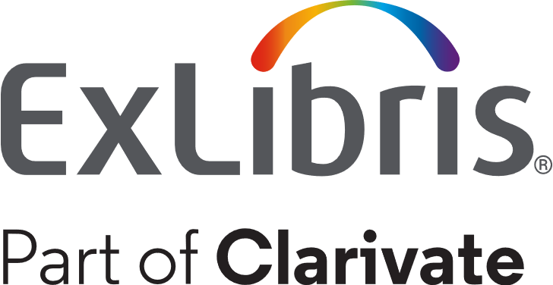
Agenda
Introduction
How does it work

Slide 3
Introduction
3

Slide 4
Introduction
When doing a Physical Items search it is possible to limit the scope of the search to specific libraries by default.
This is especially useful for institutions with many libraries, where particular staff tend to search only in specific libraries.
This reduces the need to define the library in the Advanced search or to use facets for every search.

Slide 5
How does it work
5

Slide 6
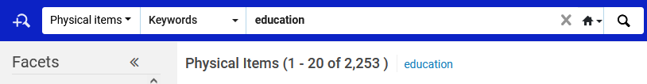
How does it work
To search in specific libraries, let’s first search for physical items in our institution.
http://qac01.alma.exlibrisgroup.com/institution/EXLDEV1_INST

Slide 7
How does it work
In the facets bar, under library scope, we can limit our search to specific libraries.
By default, if the staff user does not make any change, it will state “Library Scope: All”

Slide 8
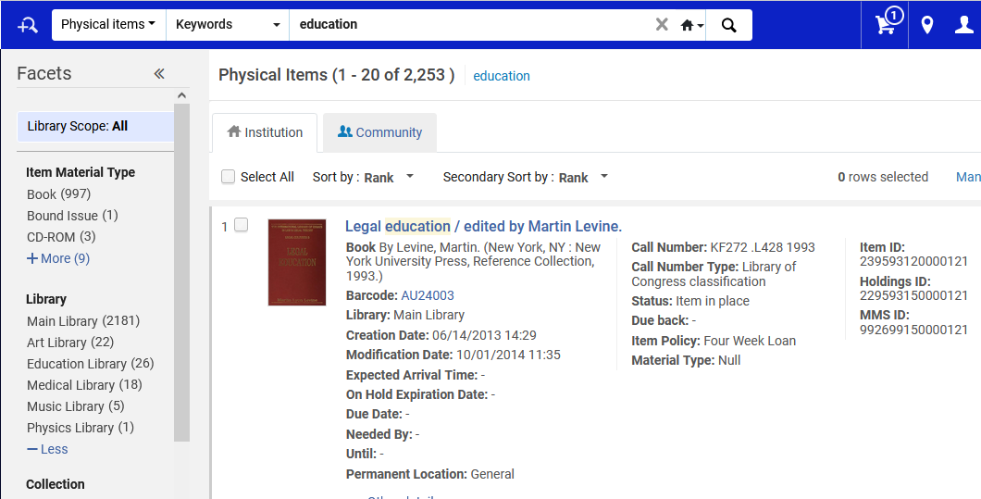
How does it work

Slide 9
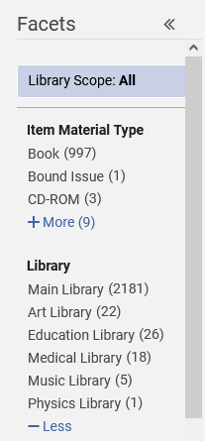
How does it work
Now we will limit our default preferred library scope to specific libraries that we primarily deal with, for example the “Art Library” and the “Education Library”. First, we will click the “Library Scope”.

Slide 10
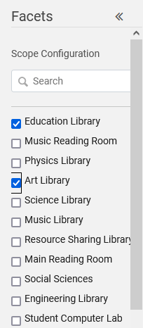
How does it work
Now we will select the desired libraries from the list

Slide 11
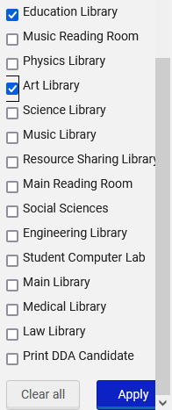
How does it work
Now we will scroll to the bottom and click “Apply”

Slide 12
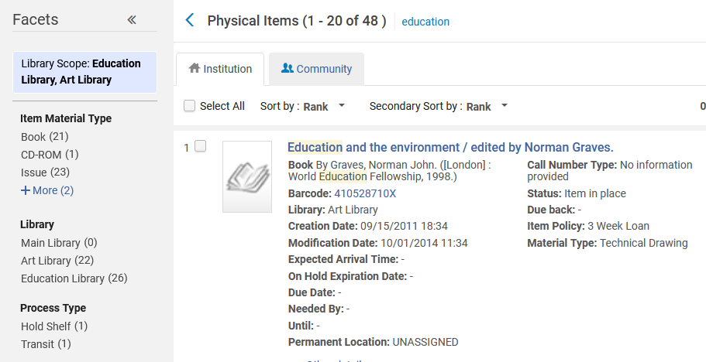
How does it work
The results are faceted to the preferred library scope

Slide 13
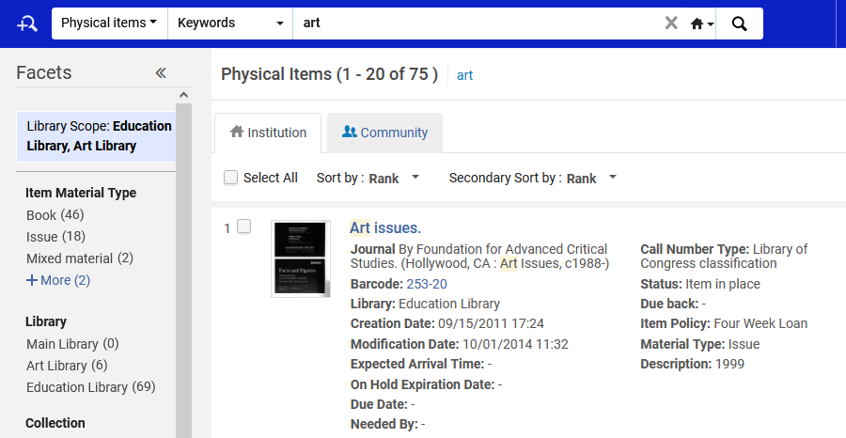
How does it work
If we log out and log in and perform another search the results are by default faceted to our preferred library scope.

Slide 14
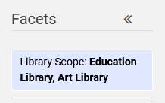
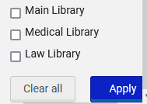
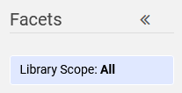
How does it work
If you want to change your preferred library scope, for example to again search all libraries, then you can click the scope and then “Clear all”.
Then you are once again searching the entire institution.

Slide 15
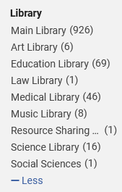
How does it work
Note that the option to facet one library at a time by clicking on the library also works, but this does not get saved throughout the session or future sessions.

